Slide 1

Sugar and Spice and All Things Nice
Research conducted in support of The Grocer, July 2015

Slide 2
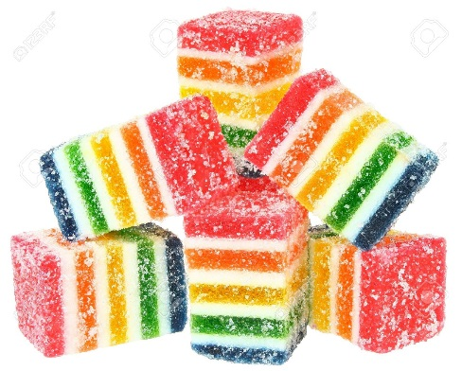
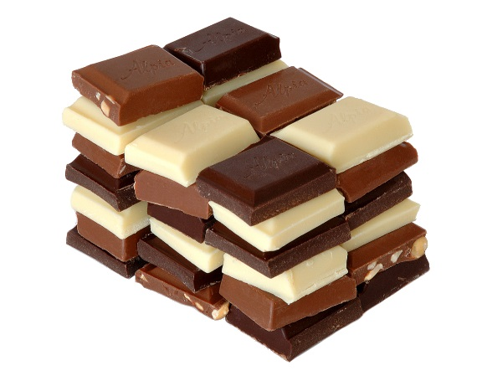
    87% of British consumers eat chocolate and/or sweets at least once a week
More than 4 in 10 (44%) eat chocolate and or sweets several times a week while 1 in 5 does so daily (22%).
Those aged 16-54 are significantly more likely than those aged 55+ to eat chocolate and/or sweets on a daily basis (25% vs 16%).
QC1. How often do you eat chocolate and/or sweets?
Base: All respondents: 2,040

Slide 3

    Consumers are divided equally on whether confectionery should be displayed at checkouts
No
53%
Yes
47%
A similar proportion of 16-24yrs think that confectionery should be displayed as those aged 55+ who think that confectionery should not be displayed (68% vs 69%).
Women were more likely than men to think that confectionery should not be displayed at the checkout (59% vs. 46%).
QC3. Do you think retailers should display confectionery at the checkout?
Base: All respondents: 2,040

Slide 4

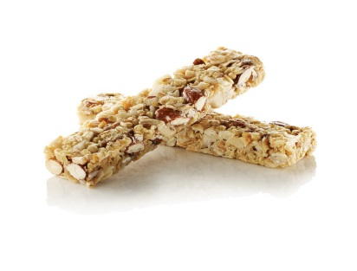


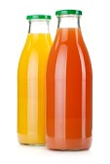

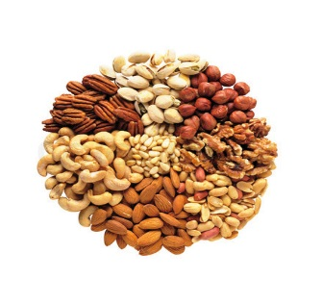

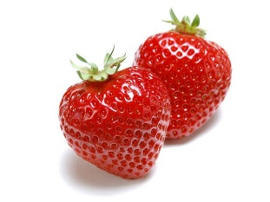


    The top three preferred replacements for confectionery at checkouts are: water, fruit snacks and nuts and seeds
Fresh fruit and vegetables rank 4th with a third (34%) preferring them as a replacement for confectionery, followed by cereal bars at around a fifth (22%).
Amongst parents, fruit snacks are the most popular replacement for confectionery at 54% followed by water at 51%.
47%
22%
8%
46%
6%
19%
42%
3%
8%
16%
34%
QC4. If no, what should retailers put at checkouts in place of confectionery? Please select all that apply. Base: All All who said retailers should not display confectionery at the checkout: 1,077

Slide 5
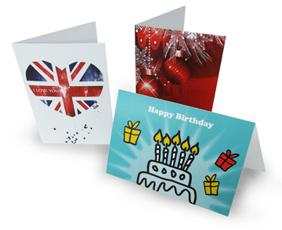

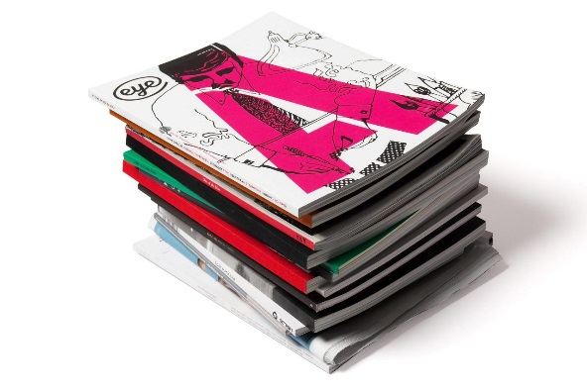
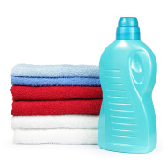
    Thinking about what else could replace confectionery at checkouts, consumers suggest..
Stationery, cards
They should not put anything at checkouts - it just encourages people to spend more
Any healthy option
Bags and items heavily discounted
Bin bags, washing liquid
Stamps, Magazines, Bags
Nothing that small children can grab
Newspapers
No edibles
QC4. If no, what should retailers put at checkouts in place of confectionery? Please select all that apply. Base: All All who said retailers should not display confectionery at the checkout: 1,077

Slide 6
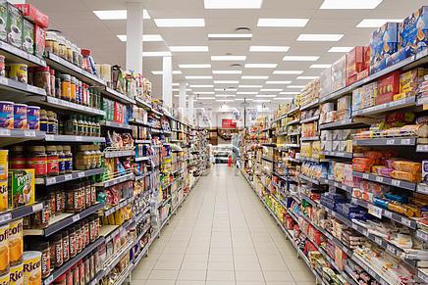
    Almost 8 in 10 consumers thought that confectionery should not be banned from other prominent places in store such as aisle ends
Women were significantly more likely than men to agree that confectionery should be banned from other prominent places in store (25% vs 21%) as are parents of children aged under 16 in comparison to people without children in that age range (28% vs 21%)
77%
Of British consumers think confectionery should not be banned from other prominent places in store such as the end of aisles while
23%
think confectionery should be banned from prominent locations in store
QC5. Do you think confectionery should be banned from other
prominent places in store, such as at the end of aisles?
Base: All respondents: 2,040

Slide 7

    Over half of consumers agree that confectionery should be enjoyed as part of a healthy balanced diet but over a quarter (27%) believe that confectionery should be removed from checkouts due to its perceived contribution to childhood obesity.
Women are significantly less likely to agree with the statement ‘I am not worried about health and eat as much confectionery as I like’ than men (8% vs 15%) while over half of women believe that confectionery should be enjoyed as part of a balanced diet (55%).
Parents with children under 16 were more likely to agree with the statement ‘I'm trying to cut down on the amount of confectionery I eat and seeing it by checkouts makes it harder to do this’ in opposition to individuals without children in that age (18% vs 12%).
53%
Confectionery should be enjoyed as part of
a healthy balanced diet
27%
Get rid of all confectionery at checkouts, the retailers are making parents lives more difficult and contributing to childhood obesity
25%
Leave confectionery at the checkouts alone, it's convenient and teaches kids a valuable lesson that they can't have everything they see
14%
I'm trying to cut down on the amount of confectionery I eat and seeing it by checkouts makes it harder to do this
13%
If I do overindulge on confectionery I make sure I do additional exercise to make up for it
12%
I'm not worried about health and eat as much confectionery as I like
QC6. Which of the below statements do you agree with?
Base: All respondents: 2,040

Slide 8
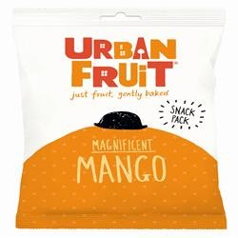
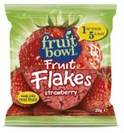
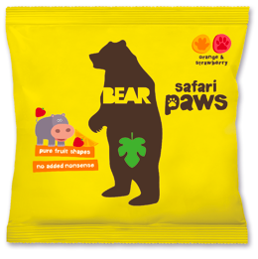
    When considering fruit snacks and whole foods such as those sold by Bear, Fruit Bowl and Urban Fruit, more than 4 in 10 consumers agreed that these products are healthier than sweets and chocolate but a similar proportion are concerned about the amount of sugar in these products
Women are significantly more likely than men to be concerned about the amount of sugar in these products (46% vs 32%). However, men were far more likely to agree that these products are unhealthier than sweets and chocolate than women (12% vs 5%).
Parents with children under 16 are significantly less concerned about the amount of sugar in these products than people without children (34% vs 41%)
44%
I think these products are healthier
than sweets and chocolate
39%
I am concerned about the amount of sugar in these products
26%
I think these products are healthy and
count towards my five a day
8%
I think these products are unhealthier
than sweets and chocolate
QC7. We now want to discuss your attitudes towards fruit snacks and whole foods, such as those sold by Bear, Fruit Bowl and Urban Fruit. Which of these statements do you agree with?
Base: All respondents: 2,040

Slide 9

    More than two thirds of consumers with a child under the age of 16 give products such as those sold by Bear, Fruit Bowl and Urban Fruit to their children.
London and Scotland are the regions most likely to give these products to their children with 76% and 78% in comparison all the rest areas which span from 51% in the East of England to 69% in the Midlands.
Yes
67%
    Give products such as fruit snacks and whole foods to their children.
No
33%
    Do not give such products to their children.
QC8. Do you give these types of products to your children?
Base: All who have a child under 16: 577

Slide 10
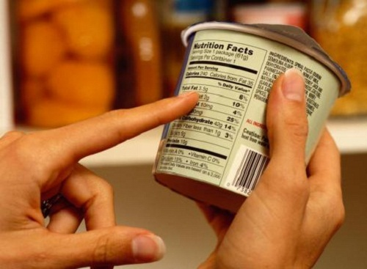
    Almost half of consumers agree that they do not really think about additives in confectionery; men are significantly more likely to state this than women (50% and 43% respectively).
Those aged 25-34 are significantly more savvy than those aged 45-54 when it comes to specifically looking for products with no additives (26% vs 19%), as are Londoners in comparison to all other regions (33% vs 15% -23%).
Parents with children under 16 years old are also significantly more aware of additives with greater likelihood to specifically look for products without additives compared to people without children (32% vs 18%).
22%
32%
47%
I specifically look for products with no additives such as artificial colours, flavours or preservatives
Sometimes I read the labels of products I pick up off the shelves to check the ingredients for additives such as artificial colours, flavours or preservatives
I don't really think about additives in confectionery
QC9. Which of the following applies to you when shopping for confectionery?
Base: All respondents: 2,040

Slide 11
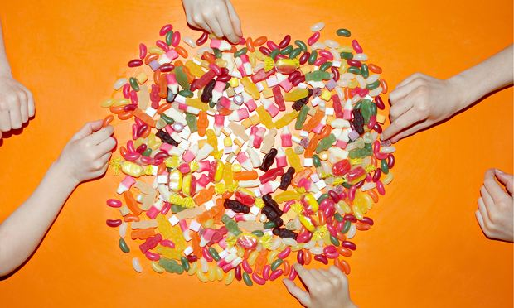
    Two thirds of consumers purchase ‘sharing bags’ of confectionery.
    14% admit to eating a full sharing bag to themselves in one sitting!
    Those aged 16-44 are the main culprits for eating them by themselves in a single sitting compared to those aged 45+ (21% vs 8%).
    Parents with children are significantly more likely to buy sharing bags in comparison to those without children (88% vs 59%).
    21% of parents admit to eating a full sharing bag by themselves in one sitting!
Net yes: 67%
QC10. Do you ever buy so-called 'sharing bags' of confectionery, and if so how do you consume them?
Base: All respondents: 2,040

Slide 12

For reference only: Just over a quarter of our respondents had at least one child under the age of 16
28 %
of our respondents had children under 16 years old
QC2.Do you have any children under 16?
Base: All All respondents: 2,040

Slide 13
Appendix –
Approach & Demographics

Slide 14

    Approach and Panel
We conducted an online omnibus survey with 2,040 adults aged 16+ across England, Scotland, and Wales between 29th June and 3rd July 2015
The survey took place using the Toluna online panel
The Harris Omnibus interviews members of the
general public who have opted in and voluntarily agreed to participate
in online research studies. Through careful recruitment and management, we are able to rapidly survey large numbers of the general population and accurately represent the views of the nation.
We have over 400,000 active panellists in the UK and our panel is used solely for market and opinion research. Members are contacted at random and invited to take part in a survey.

Slide 15
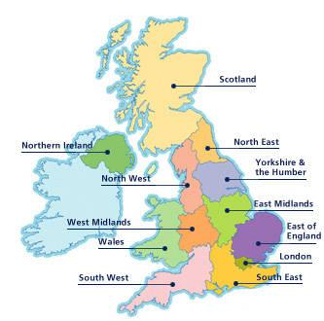
    Omnibus Audience – a representative sample
The results of the study were weighted to best reflect the size and shape of the population of Great Britain
This means that the results in this report reflect an audience that is as true as possible of the population with the same age, gender and regional profile. The audience profile is detailed below.
Of course not everyone in GB has internet access, but online panel research results are considered to be extremely accurate. In fact, according to the British Polling Council, Harris Interactive was the most accurate online polling company during the last UK elections in 2010: http://www.britishpollingcouncil.org/press100508.html
Region
9%
4%
Gender
Age
N/A
12%
9%
16%
9%
5%
12%
9%
14%
49%
51%

Slide 16
For Further Information please contact :
Lucia Juliano | Head of Consumer & Retail Research | LJuliano@harrisinteractive.co.uk
079 89 39 22 51 | 0161 242 1365 | 0161 242 1360

